Slide 1

Harmony in Complexity: Unveiling Mathematical Unity Across Logistic Regression, Artificial Neural Networks and Computer Vision
Liliang Chen
Freddie Mac
chenliliang@gmail.com

Slide 2
Disclaimer
This deck reflects my personal opinion and does not necessarily reflect the position or viewpoint of Freddie Mac.

Slide 3
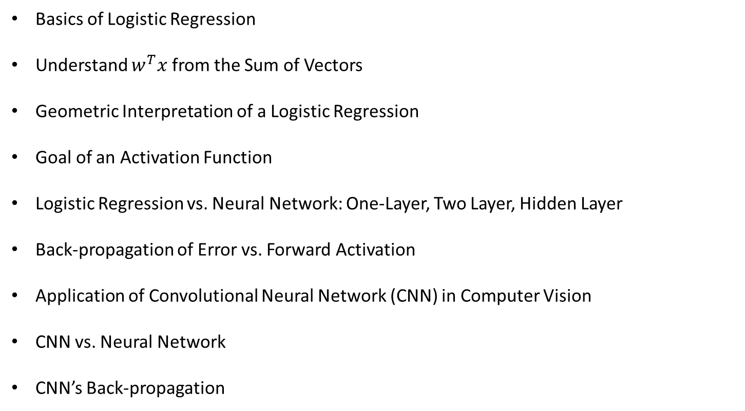
Agenda
Basics of Logistic Regression
Understand $w^{T}x$ from the Sum of Vectors
Geometric Interpretation of a Logistic Regression
Goal of an Activation Function
Logistic Regression vs. Neural Network: One-Layer, Two Layer, Hidden Layer
Back-propagation of Error vs. Forward Activation
Application of Convolutional Neural Network (CNN) in Computer Vision
CNN vs. Neural Network
CNN’s Back-propagation

Slide 4
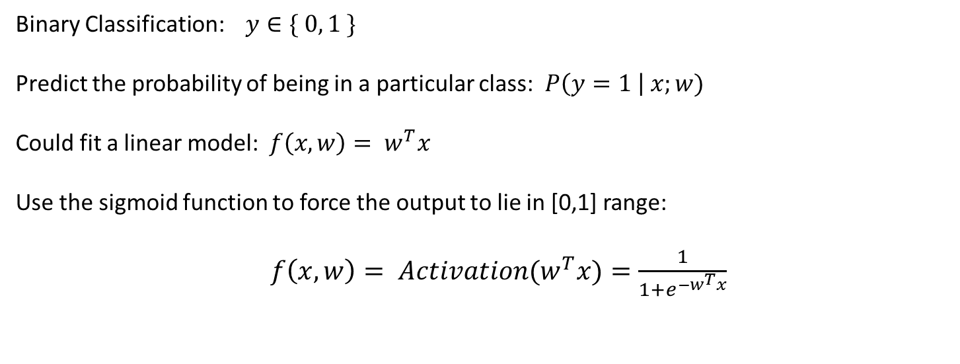
Basics of Logistic Regression
Binary Classification: $y∈\{ 0, 1 \}$
Predict the probability of being in a particular class: $P\left(y=1 \right| x;w)$
Could fit a linear model: $f\left(x,w\right)= w^{T}x$
Use the sigmoid function to force the output to lie in [0,1] range:
$f\left(x,w\right)= {Activation(w}^{T}x)=\frac{1}{1+e^{−w^{T}x}}$

Slide 5
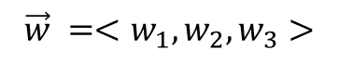

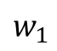
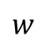
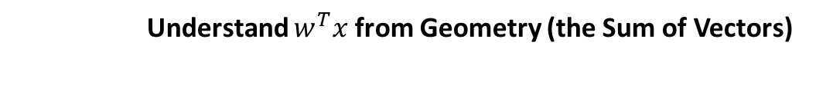
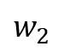
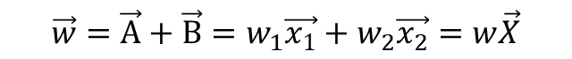
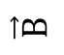
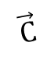
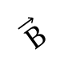
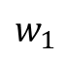
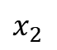
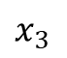
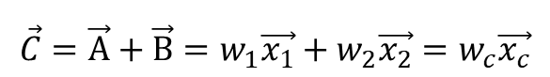
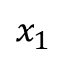
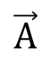
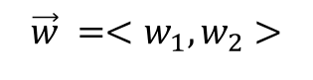
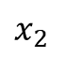
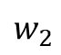
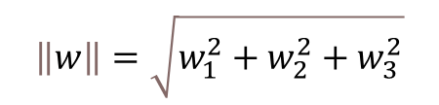
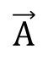
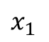

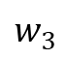
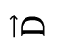
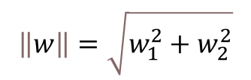
Understand $w^{T}x$ from Geometry (the Sum of Vectors)
Vector addition in 2D
Vector addition in 3D
$x_{2}$
$x_{3}$
$$\vec{w}$$
$$\vec{D}$$
$x_{2}$
$$w_{3}$$
$$\vec{w}$$
$$\vec{B}$$
$$w$$
$$w_{2}$$
$$\vec{B}$$
$$\vec{C}$$
$$w_{2}$$
$$w_{1}$$
$$\vec{A}$$
$x_{1}$
$$w_{1}$$
$$\vec{A}$$
$x_{1}$
$$\vec{w}=\vec{A}+\vec{B}=w_{1}\vec{x_{1}}+w_{2}\vec{x_{2}}=w\vec{X}$$
$$\vec{C}=\vec{A}+\vec{B}=w_{1}\vec{x_{1}}+w_{2}\vec{x_{2}}=w_{c}\vec{x_{c}}$$
$\vec{w}=\vec{C}+\vec{D}=w_{c}\vec{x_{c}}+w_{3}\vec{x_{3}}=w_{1}\vec{x_{1}}+w_{2}\vec{x_{2}}$ $+w_{3}\vec{x_{3}}$ $=w\vec{X}$
$$\vec{w} =<w_{1},w_{2}>$$
$$\vec{w} =<w_{1},w_{2},w_{3}>$$
$$\left\|w\right\|=\sqrt{w_{1}^{2}+w_{2}^{2}}$$
$$\left\|w\right\|=\sqrt{w_{1}^{2}+w_{2}^{2}+w_{3}^{2}}$$
W$e can think of w^{T}x as tranforming from multiple independent vectors$
$$into a single vector with a deterministic direction and magnitude$$

Slide 6

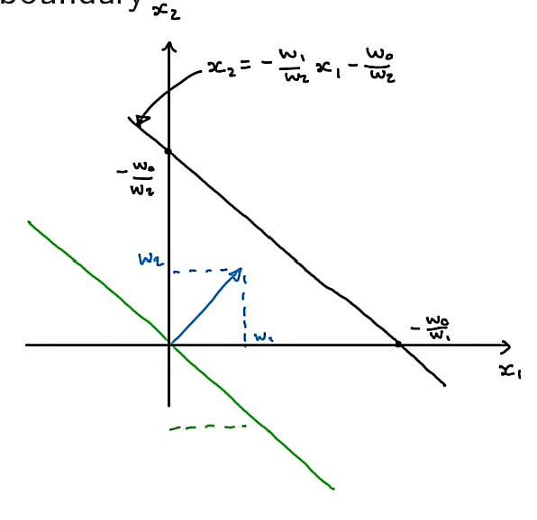

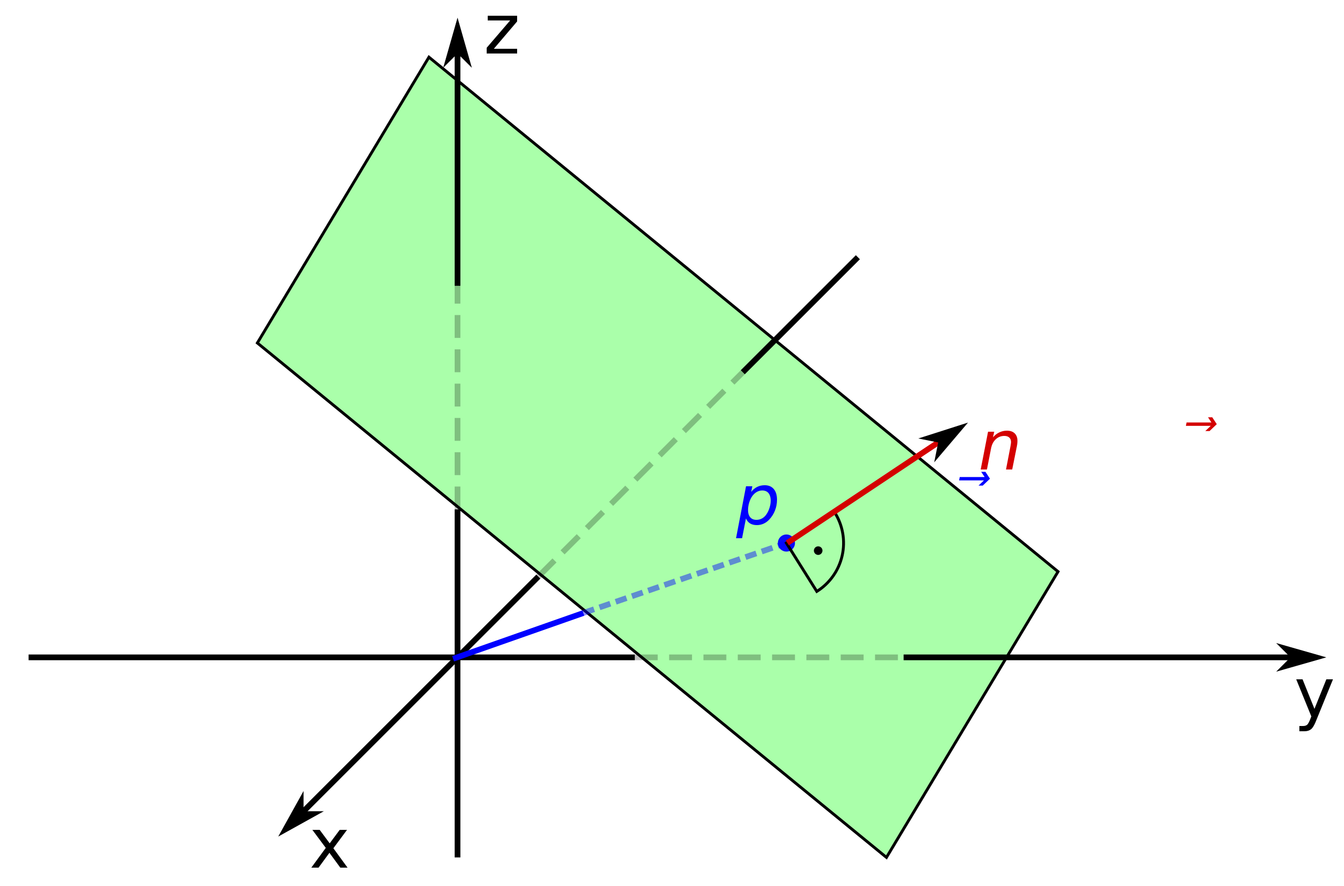

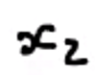

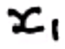
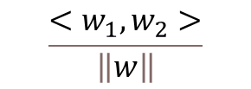

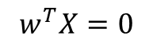

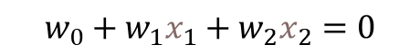
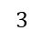
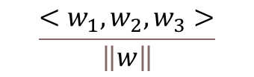
Understanding the linear model shape $w^{T}x=0 \text{from} \text{geometry}$
$$w^{T}X=0$$
defines a line in a two-dimension space vs a hyper-plane in a three-dimension space
The unit vector normal to the line/plane has the same direction as the sum of vectors based on individual vectors.
$$w_{0}+w_{1}x_{1}+w_{2}x_{2}=0$$
$$w_{0}+w_{1}x_{1}+w_{2}x_{2}+w_{3}x_{3}=0$$
The unit vector normal to this line is
$$\frac{<w_{1},w_{2}>}{\left\|w\right\|}$$
The unit vector normal to above plane is
$$\frac{<w_{1},w_{2},w_{3}>}{\left\|w\right\|}$$
$$3$$
$$\vec{w}$$
$$\vec{w}$$

Slide 7
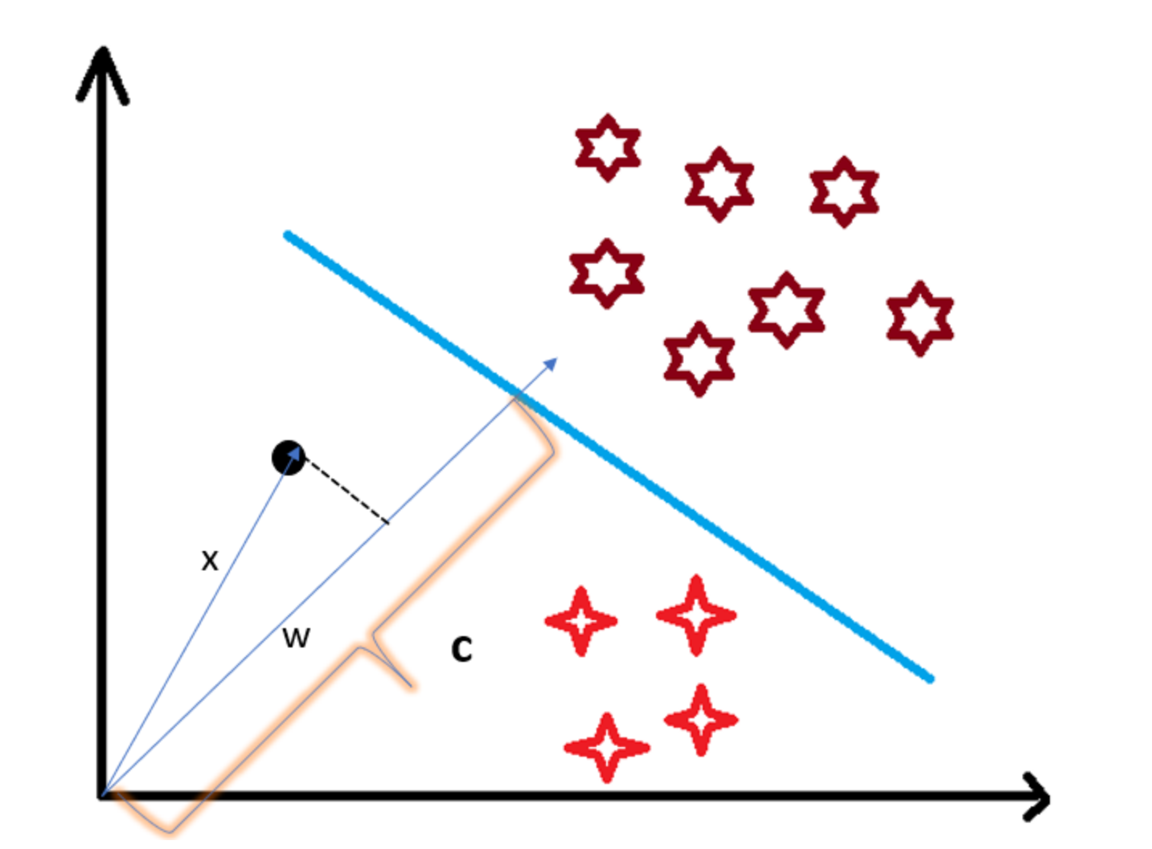
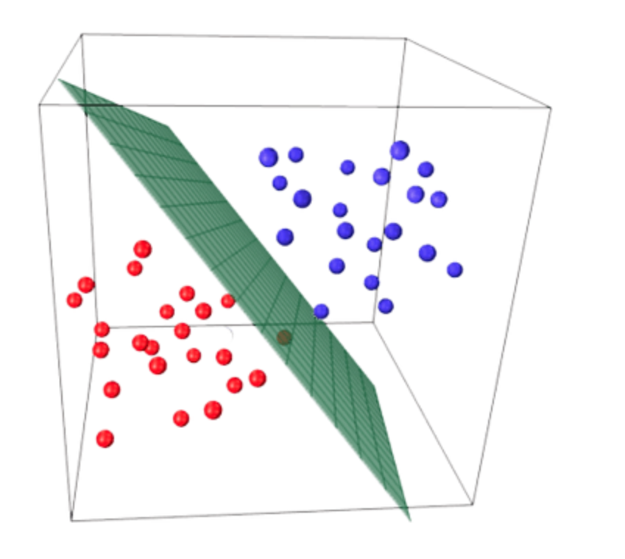




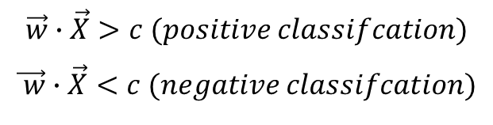
Geometric Interpretation of a Logistic Regression
Decision Boundary as a line in 2D
Decision Boundary as a hyperplane in 3D*
Logistic regression seeks the decision boundary to perfect linear separate positive and negative points;
Classification depends on the relative distance to the origin between the points vs. the decision boundary.
$$\vec{w}∙\vec{X}=c (the point lies on the decision boundary)$$
$$\vec{w}∙\vec{X}>c (positive classifcation)$$
$$\vec{ w}∙\vec{X}<c (negative classifcation)$$

Slide 8
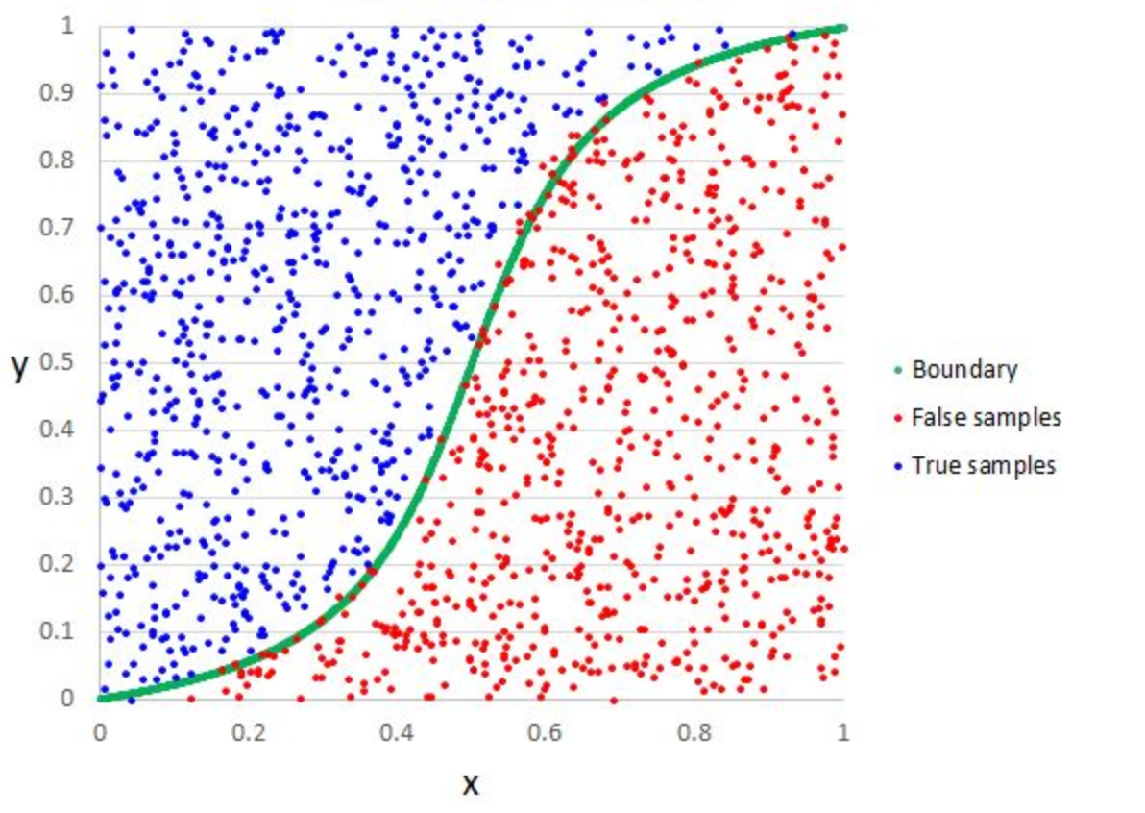

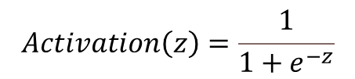
Goal of an Activation Function
Activation function translates a line into a nonlinear decision boundary in a 2D space;
Logistic regression normally choose sigmoid function as its activation function:
$$Activation\left(z\right)=\frac{1}{1+e^{−z}}$$
Decision Boundary

Slide 9
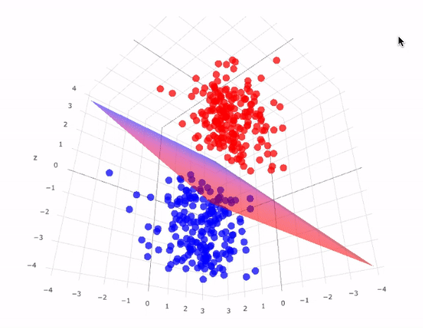
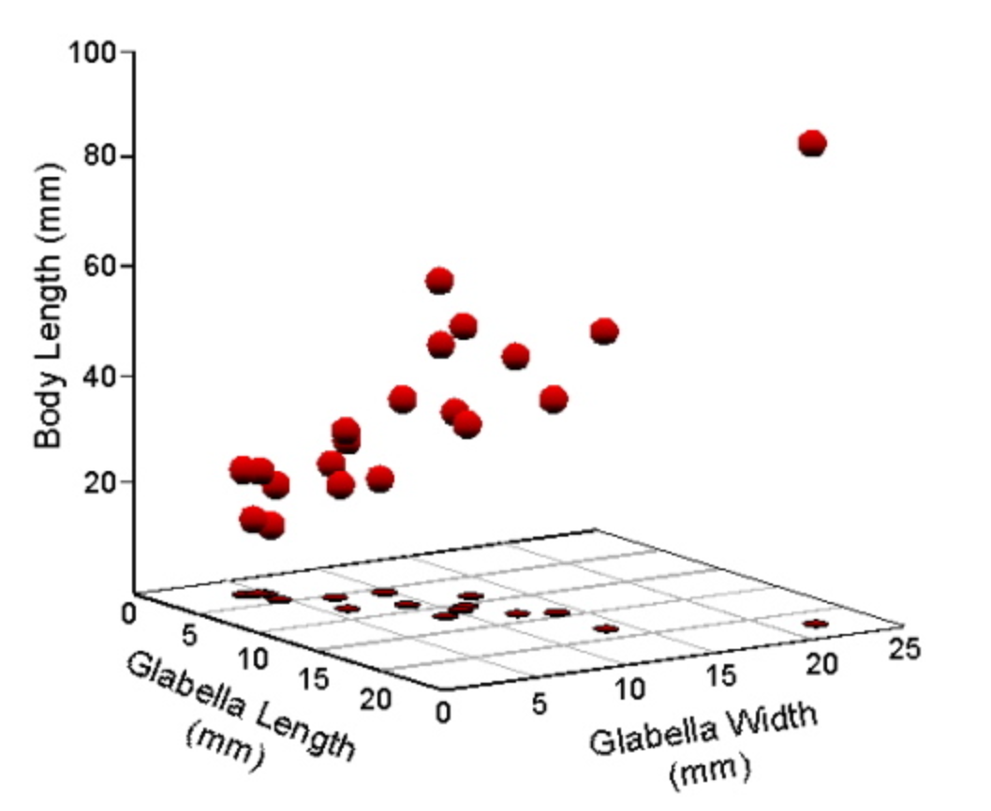



Decision Boundary in a Hyper-dimension Space
Activation function translates a hyperplane into a complex decision boundary in a higher dimension space
*Source: Deep Learning: Feed Forward Neural Networks (FFNNS) ---- Medium

Slide 10
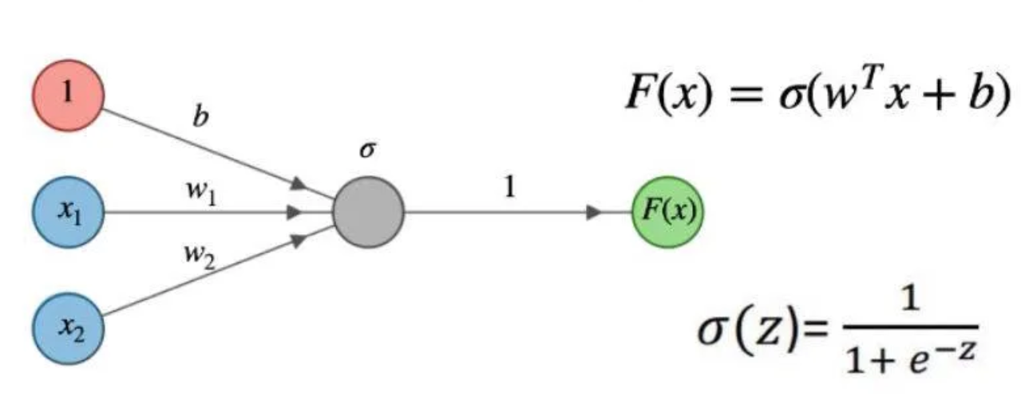


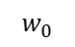
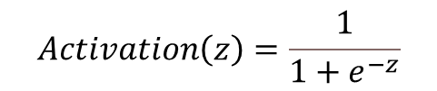
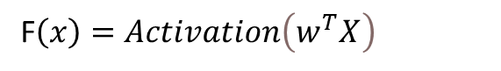
Understand logistic Regression from a One-layer Neural Network
$$w_{0}$$
One-layer neural network can be formulated as
F$\left(x\right)=Activation\left(w_{0}+w_{1}x_{1}+w_{2}x_{2}+…+w_{n}x_{n}\right)$
Rewrite using vectorized form, we get
F$\left(x\right)=Activation\left(w^{T}X\right)$
which has exactly mathematical formula as for a logistic regression.
Logistic regression uses below sigmoid activation function:
$$Activation\left(z\right)=\frac{1}{1+e^{−z}}$$
while a neural network can have more activation function variation.
A logistic regression can be thought of a special case of one-layer neural network.

Slide 11
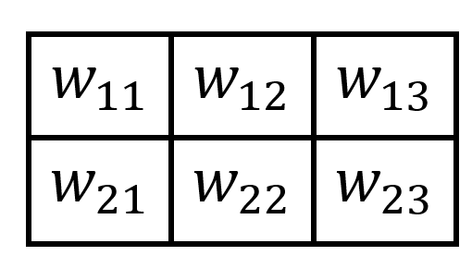
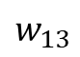
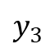
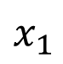
















Two-layer Neural Networks
$w_{11}$
$y_{1}$
$x_{1}$
$w_{12}$
$y_{1}$
$y_{2}$
$y_{3}$
$w_{13}$
$x_{1}$
$y_{2}$
Z
$w_{21}$
$x_{2}$
$x_{2}$
$w_{22}$
$w_{23}$
$y_{3}$
Input
Hidden Layer
Output
${\left[\begin{matrix}w_{11} & w_{12} & w_{13} \\ w_{21} & w_{22} & w_{23}\end{matrix}\right]}^{T}\left[\begin{matrix}x_{1} \\ x_{2}\end{matrix}\right]$=$\left[\begin{matrix}w_{11}x_{1}+w_{21}x_{2} \\ w_{12}x_{1}+w_{22}x_{2} \\ w_{13}x_{1}+w_{23}x_{2}\end{matrix}\right]$=$\left[\begin{matrix}y_{1} \\ y_{2} \\ y_{3}\end{matrix}\right]$
$$Y=Activation\left(w_{x}^{T}X\right)$$
$$Z=Activation\left(w_{y}^{T}Y\right)$$
Adding a layer will add the complexity of the networks, but the general forward activation form is the same

Slide 12







The Necessity of One Hidden Layer
A hidden layer is needed since the decision boundaries could be nonlinear;
We use the combination of different decision boundaries to construct the final decision boundary;
Different decision boundaries require us to adopt hidden layers with different features space.
$$w_{11}x_{1}+w_{21}x_{2}+w_{01}=0$$
$x_{1}$
$x_{2}$
$$w_{21}x_{1}+w_{22}x_{2}+w_{02}=0$$

Slide 13











Two Hidden-layer Neural Networks
$$X$$
$$Y$$
$$Z$$
$$H$$
$$X=\left[\begin{matrix}x_{1} \\ x_{2} \\ \begin{matrix}… \\ x_{n}\end{matrix}\end{matrix}\right]$$
$$w_{x}^{T}=\left[\begin{matrix}w_{11} & w_{12} & \begin{matrix}… & w_{1n}\end{matrix} \\ w_{21} & w_{22} & \begin{matrix}… & w_{2n}\end{matrix} \\ \begin{matrix}⋯ \\ w_{m1}\end{matrix} & \begin{matrix}⋯ \\ w_{m2}\end{matrix} & \begin{matrix}\begin{matrix}⋯ & ⋯\end{matrix} \\ \begin{matrix}⋯ & w_{mn}\end{matrix}\end{matrix}\end{matrix}\right]$$
$$Y=\left[\begin{matrix}y_{1} \\ y_{2} \\ \begin{matrix}… \\ y_{n}\end{matrix}\end{matrix}\right]$$
$$Y=Activation\left(w_{x}^{T}X\right)$$
$$Z=Activation\left(w_{y}^{T}Y\right)$$
$$H=Activation\left(w_{z}^{T}T\right)$$
With more hidden layers, we have more freedom to transform between different spaces.

Slide 14









Compare Similarity of back-propagation of error with the Forward Activation
The error of each neuron is proportional to its weight:
$$E\left(x_{1}\right)=\frac{w_{11}}{w_{11}+w_{21}}E\left(y_{1}\right)+\frac{w_{12}}{w_{12}+w_{22}}E\left(y_{2}\right)+\frac{w_{13}}{w_{13}+w_{23}}E\left(y_{3}\right)$$
$w_{11}$
$y_{1}$
$x_{1}$
$w_{12}$
$$E\left(x_{2}\right)=\frac{w_{21}}{w_{11}+w_{21}}E\left(y_{1}\right)+\frac{w_{22}}{w_{12}+w_{22}}E\left(y_{2}\right)+\frac{w_{23}}{w_{13}+w_{23}}E\left(y_{3}\right)$$
$w_{13}$
$y_{2}$
Z
$w_{21}$
$$\left[\begin{matrix}\left.{E\left(x\right.}_{1}\right) \\ \left.{E\left(x\right.}_{2}\right)\end{matrix}\right]=\left[\begin{matrix}\frac{w_{11}}{w_{11}+w_{21}} & \frac{w_{12}}{w_{12}+w_{22}} & \frac{w_{13}}{w_{13}+w_{23}} \\ \frac{w_{21}}{w_{11}+w_{21}} & \frac{w_{22}}{w_{12}+w_{22}} & \frac{w_{23}}{w_{13}+w_{23}}\end{matrix}\right]\left[\begin{matrix}\left.{E\left(y\right.}_{1}\right) \\ \left.{E\left(y\right.}_{2}\right) \\ \left.{E\left(y\right.}_{3}\right)\end{matrix}\right]$$
$x_{2}$
$w_{22}$
$w_{23}$
$y_{3}$
Output
Normalize above equation to simplify it as:
Input
Hidden Layer
$$\left[\begin{matrix}\left.{E\left(x\right.}_{1}\right) \\ \left.{E\left(x\right.}_{2}\right)\end{matrix}\right]=\left[\begin{matrix}w_{11} & w_{12} & w_{13} \\ w_{21} & w_{22} & w_{23}\end{matrix}\right]\left[\begin{matrix}\left.{E\left(y\right.}_{1}\right) \\ \left.{E\left(y\right.}_{2}\right) \\ \left.{E\left(y\right.}_{3}\right)\end{matrix}\right]$$
Forward activation has same multiplier
Below is a general equation of the back-propagation algorithm
Y$= w^{T}X$
$$E_{n}=w^{T}E_{n+1}$$
Adjust weight based on
$$w_{i}^{n}=w_{i}^{n}−α\frac{∂E_{n}}{∂w_{i}^{n}}$$

Slide 15

Application of Convolutional Neural Network (CNN) in Computer Vision
Convolutional Neural Networks (CNN) are a type of neural network
widely used in images recognition, images classifications, and objects detections
Computer reads images as pixels and expresses them as matrix
Three basic components: Convolution layer, Flatten layer, Fully connected layer
Filter (Kernel) is worked as the weight
Source: What is Convolutional Neural Network – CNN (Deep Learning)

Slide 16






















Convolutional Neural Network
$x_{1}$
$$w_{1}$$
$x_{2}$
$$w_{2}$$
Input Image
Filter
Feature Map
$x_{3}$
$y_{1}$
$$w_{3}$$
$$x_{1}$$ | $$x_{2}$$ | $$x_{3}$$
$$x_{4}$$ | $$x_{5}$$ | $$x_{6}$$
$$x_{7}$$ | $$x_{8}$$ | $$x_{9}$$
$$y_{1}$$ | $$y_{2}$$
$$y_{3}$$ | $$y_{4}$$
$$∗$$
$$w_{1}$$ | $$w_{2}$$
$$w_{3}$$ | $$w_{4}$$
=
$x_{4}$
$y_{2}$
$$w_{4}$$
$x_{5}$
$y_{3}$
The forward Pass of convolutional layer
$x_{6}$
$y_{4}$
$y_{1}$ ${=w}_{1}x_{1}+w_{2}x_{2}+w_{3}x_{4}$ $+w_{3}x_{5}$
$x_{7}$
$x_{8}$
$x_{9}$

Slide 17








Convolutional Neural Network
$x_{1}$
$x_{2}$
$$w_{1}$$
Input Image
Kernel
Feature Map
$x_{3}$
$y_{1}$
$$x_{1}$$ | $$x_{2}$$ | $$x_{3}$$
$$x_{4}$$ | $$x_{5}$$ | $$x_{6}$$
$$x_{7}$$ | $$x_{8}$$ | $$x_{9}$$
$$w_{2}$$
$$∗$$
$$w_{1}$$ | $$w_{2}$$
$$w_{3}$$ | $$w_{4}$$
=
$$y_{1}$$ | $$y_{2}$$
$$y_{3}$$ | $$y_{4}$$
$x_{4}$
$y_{2}$
$$w_{3}$$
$x_{5}$
$y_{3}$
The forward Pass of convolutional layer
$$w_{4}$$
$x_{6}$
$y_{4}$
$y_{2}$ ${=w}_{1}x_{2}+w_{2}x_{3}+w_{3}x_{5}$ $+w_{3}x_{6}$
$x_{7}$
$x_{8}$
$x_{9}$

Slide 18







Convolutional Neural Network
$x_{1}$
$x_{2}$
Input Image
Kernel
Feature Map
$x_{3}$
$y_{1}$
$$x_{1}$$ | $$x_{2}$$ | $$x_{3}$$
$$x_{4}$$ | $$x_{5}$$ | $$x_{6}$$
$$x_{7}$$ | $$x_{8}$$ | $$x_{9}$$
$$y_{1}$$ | $$y_{2}$$
$$y_{3}$$ | $$y_{4}$$
$$∗$$
$$w_{1}$$ | $$w_{2}$$
$$w_{3}$$ | $$w_{4}$$
=
$x_{4}$
$$w_{1}$$
$y_{2}$
$x_{5}$
$$w_{2}$$
$y_{3}$
The forward Pass of convolutional layer
$x_{6}$
$$w_{3}$$
$y_{4}$
$y_{3}$ ${=w}_{1}x_{4}+w_{2}x_{5}+w_{3}x_{7}$ $+w_{3}x_{8}$
$x_{7}$
$$w_{4}$$
$x_{8}$
$x_{9}$

Slide 19







Convolutional Neural Network
$x_{1}$
$x_{2}$
Input Image
Kernel
Feature Map
$x_{3}$
$y_{1}$
$$x_{1}$$ | $$x_{2}$$ | $$x_{3}$$
$$x_{4}$$ | $$x_{5}$$ | $$x_{6}$$
$$x_{7}$$ | $$x_{8}$$ | $$x_{9}$$
$$y_{1}$$ | $$y_{2}$$
$$y_{3}$$ | $$y_{4}$$
$$∗$$
$$w_{1}$$ | $$w_{2}$$
$$w_{3}$$ | $$w_{4}$$
=
$x_{4}$
$y_{2}$
$x_{5}$
$$w_{1}$$
$y_{3}$
The forward Pass of convolutional layer
$x_{6}$
$$w_{2}$$
$y_{4}$
$y_{4}$ ${=w}_{1}x_{5}+w_{2}x_{6}+w_{3}x_{8}$ $+w_{3}x_{9}$
$x_{7}$
$$w_{3}$$
$x_{8}$
$$w_{4}$$
$x_{9}$

Slide 20















































Comparison of Neural Networks vs Convolutional Neural Networks
$x_{1}$
$x_{1}$
$y_{1}$
$y_{2}$
$y_{3}$
$y_{4}$
$y_{1}$
$y_{2}$
$y_{3}$
$y_{4}$
$x_{2}$
$x_{1}$
$x_{2}$
$x_{2}$
$x_{3}$
$y_{1}$
$x_{3}$
$y_{1}$
$x_{3}$
$x_{4}$
$y_{2}$
$x_{4}$
$x_{4}$
$y_{2}$
$x_{5}$
$x_{5}$
$y_{3}$
$x_{6}$
$x_{5}$
$y_{3}$
$y_{4}$
$x_{7}$
$x_{6}$
$y_{4}$
$x_{6}$
$x_{8}$
$x_{7}$
$x_{9}$
$x_{7}$
$$Y=Activation\left(w^{T}X\right)$$
Y $=conv(w∗X)$
$x_{8}$
$x_{8}$
Difficult to understand
More weight parameter
Global impact from input
Can be visually understandable
Fewer weight due to weight sharing
Localized impact from input
$x_{9}$
$x_{9}$

Slide 21


















Convolutional Neural Network Back-propagation
$x_{1}$
$x_{2}$
Input Image
Kernel
Feature Map
$x_{3}$
$y_{1}$
$$x_{1}$$ | $$x_{2}$$ | $$x_{3}$$
$$x_{4}$$ | $$x_{5}$$ | $$x_{6}$$
$$x_{7}$$ | $$x_{8}$$ | $$x_{9}$$
$$y_{1}$$ | $$y_{2}$$
$$y_{3}$$ | $$y_{4}$$
$$∗$$
$$w_{1}$$ | $$w_{2}$$
$$w_{3}$$ | $$w_{4}$$
=
$x_{4}$
$y_{2}$
$Z$
$L$
$x_{5}$
$y_{3}$
Weight adjustment is:
$$w_{i}^{n}=w_{i}^{n−1}−α\frac{∂L}{∂w_{i}}$$
$x_{6}$
$y_{4}$
The loss gradient based on the chain rule
$x_{7}$
$\frac{∂L}{∂w_{i}}=$ $\frac{∂L}{∂z}\frac{∂z}{∂y_{j}}\frac{∂y_{j}}{∂w_{i}}=\frac{∂L}{∂y_{1}}\frac{∂y_{1}}{∂w_{i}}+\frac{∂L}{∂y_{2}}\frac{∂y_{2}}{∂w_{i}}+\frac{∂L}{∂y_{3}}\frac{∂y_{3}}{∂w_{i}}$ $+\frac{∂L}{∂y_{4}}\frac{∂y_{4}}{∂w_{i}}$
$x_{8}$
$x_{9}$

Slide 22














Convolutional Neural Network Back-propagation
Convolutional function of forward pass
Local gradient w.r.t the filter
$y_{1}$ ${=w}_{1}x_{1}+w_{2}x_{2}+w_{3}x_{4}$ $+w_{4}x_{5}$
$\frac{∂y_{1}}{∂w_{1}}$=$x_{1}$ | $\frac{∂y_{1}}{∂w_{2}}$=$x_{2}$ | $\frac{∂y_{1}}{∂w_{3}}$=$x_{4}$ | $\frac{∂y_{1}}{∂w_{4}}\text{=}x_{5}$
$\frac{∂y_{2}}{∂w_{1}}$=$x_{2}$ | $\frac{∂y_{2}}{∂w_{2}}$=$x_{3}$ | $\frac{∂y_{2}}{∂w_{3}}$=$x_{5}$ | $\frac{∂y_{2}}{∂w_{4}}\text{=}x_{6}$
$\frac{∂y_{3}}{∂w_{1}}$=$x_{4}$ | $\frac{∂y_{3}}{∂w_{2}}$=$x_{5}$ | $\frac{∂y_{3}}{∂w_{3}}$=$x_{7}$ | $\frac{∂y_{3}}{∂w_{4}}\text{=}x_{8}$
$\frac{∂y_{4}}{∂w_{1}}$=$x_{5}$ | $\frac{∂y_{4}}{∂w_{2}}$=$x_{6}$ | $\frac{∂y_{4}}{∂w_{3}}$=$x_{8}$ | $\frac{∂y_{4}}{∂w_{4}}\text{=}x_{9}$
$y_{2}$ ${=w}_{1}x_{2}+w_{2}x_{3}+w_{3}x_{5}$ $+w_{4}x_{6}$
$y_{3}$ ${=w}_{1}x_{4}+w_{2}x_{5}+w_{3}x_{7}$ $+w_{4}x_{8}$
$y_{4}$ ${=w}_{1}x_{5}+w_{2}x_{6}+w_{3}x_{8}$ $+w_{4}x_{9}$
Loss gradient w.r.t the filter
$$\frac{∂L}{∂w_{1}}=\frac{∂L}{∂y_{1}}x_{1}+\frac{∂L}{∂y_{2}}x_{2}+\frac{∂L}{∂y_{3}}x_{4}+\frac{∂L}{∂y_{4}}x_{5}$$
Rewrite using Convolution operator
$$\frac{∂L}{∂w_{2}}=\frac{∂L}{∂y_{1}}x_{1}+\frac{∂L}{∂y_{2}}x_{3}+\frac{∂L}{∂y_{3}}x_{5}+\frac{∂L}{∂y_{4}}x_{6}$$
$$\frac{∂L}{∂w_{1}}$$ | $$\frac{∂L}{∂w_{2}}$$
$$\frac{∂L}{∂w_{3}}$$ | $$\frac{∂L}{∂w_{4}}$$
$$x_{1}$$ | $$x_{2}$$ | $$x_{3}$$
$$x_{4}$$ | $$x_{5}$$ | $$x_{6}$$
$$x_{7}$$ | $$x_{8}$$ | $$x_{9}$$
$$\frac{∂L}{∂y_{1}}$$ | $$\frac{∂L}{∂y_{2}}$$
$$\frac{∂L}{∂y_{3}}$$ | $$\frac{∂L}{∂y_{4}}$$
=
Conv
$$∗$$
$$\frac{∂L}{∂w_{2}}=\frac{∂L}{∂y_{1}}x_{4}+\frac{∂L}{∂y_{2}}x_{5}+\frac{∂L}{∂y_{3}}x_{7}+\frac{∂L}{∂y_{4}}x_{8}$$
$$\frac{∂L}{∂w_{2}}=\frac{∂L}{∂y_{1}}x_{5}+\frac{∂L}{∂y_{2}}x_{6}+\frac{∂L}{∂y_{3}}x_{8}+\frac{∂L}{∂y_{4}}x_{9}$$
$\frac{∂L }{∂w}$ = Conv ( $\frac{∂L}{∂Y}\text{∗}\text{X})$

Slide 23

Conclusion

Slide 24
Thanks!

